Slide 1
Class 11:
Mining Pools and Attacks
Cryptocurrency Café
UVa cs4501 Spring 2015
David Evans

Slide 2
Plan for Today
PointCoin Update
Mining Pools
Attacks and Vulnerabilities

Slide 3

Snow Day!

Slide 4
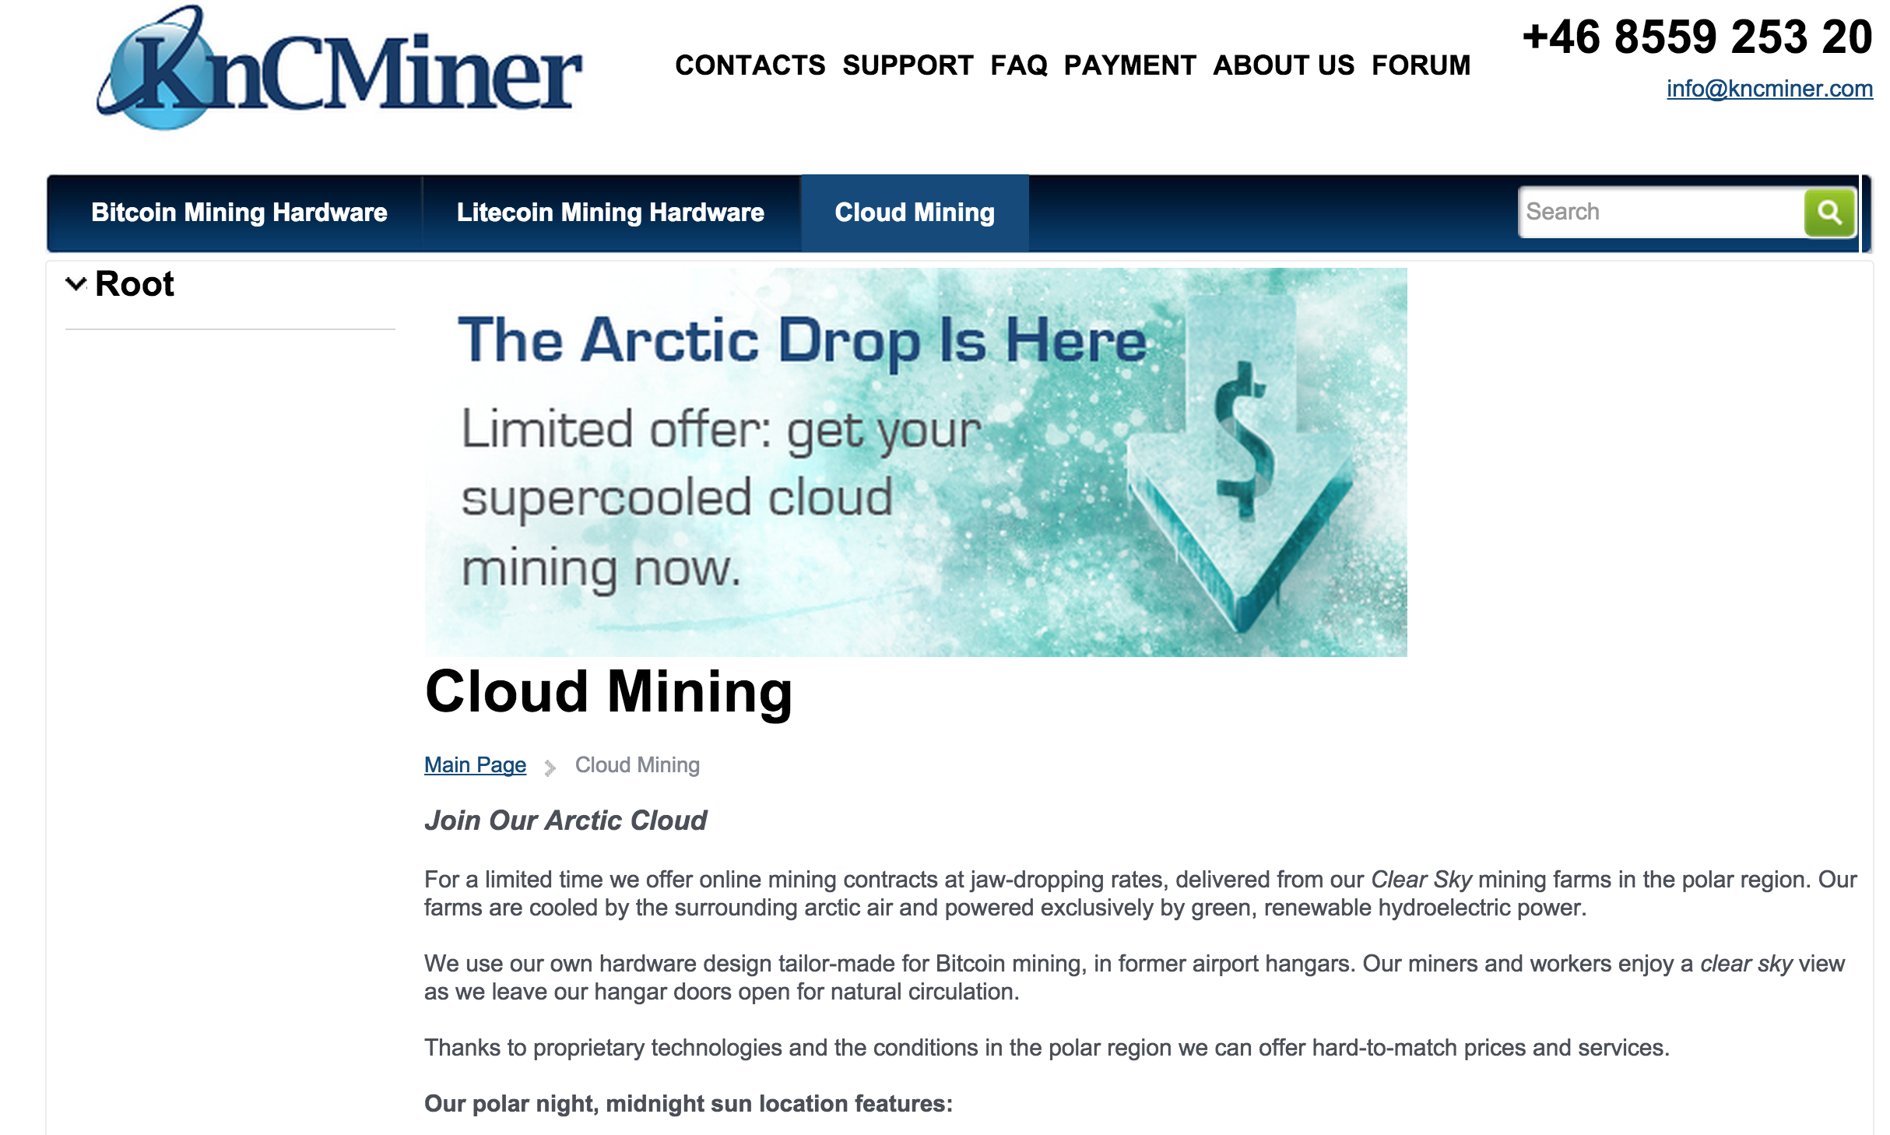

Slide 5

Is this gambling or a “good/bad” investment?

Slide 6
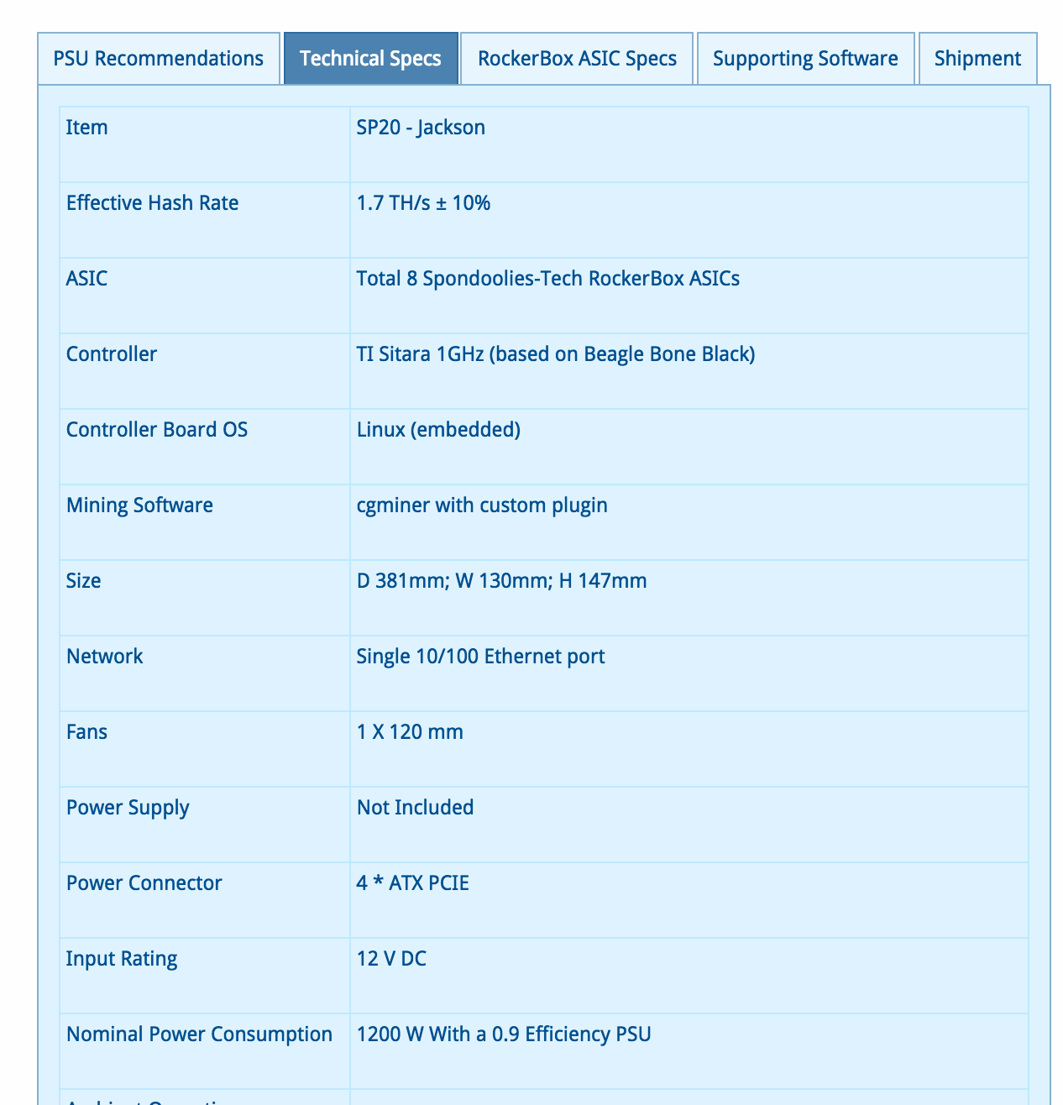

Slide 7
Expected Revenues (?)
Model
Cost: US$ 479
1.7 TH/s
BTC: US$ 240
Difficulty: (today)
>>> expected_hashes # at current difficulty
1.9093455768686638e+20
>>> expected_hashes / (1.7 * 10**12)
112314445.6981567 # expected seconds to find block
>>> _ / (60 * 60 * 24)
1299.935714099036 # days to find block
>>> block_value = 240 * 25
>>> earnings_per_year = block_value * (365.25 / 1300)
>>> earnings_per_year
1685.769230769231

Slide 8
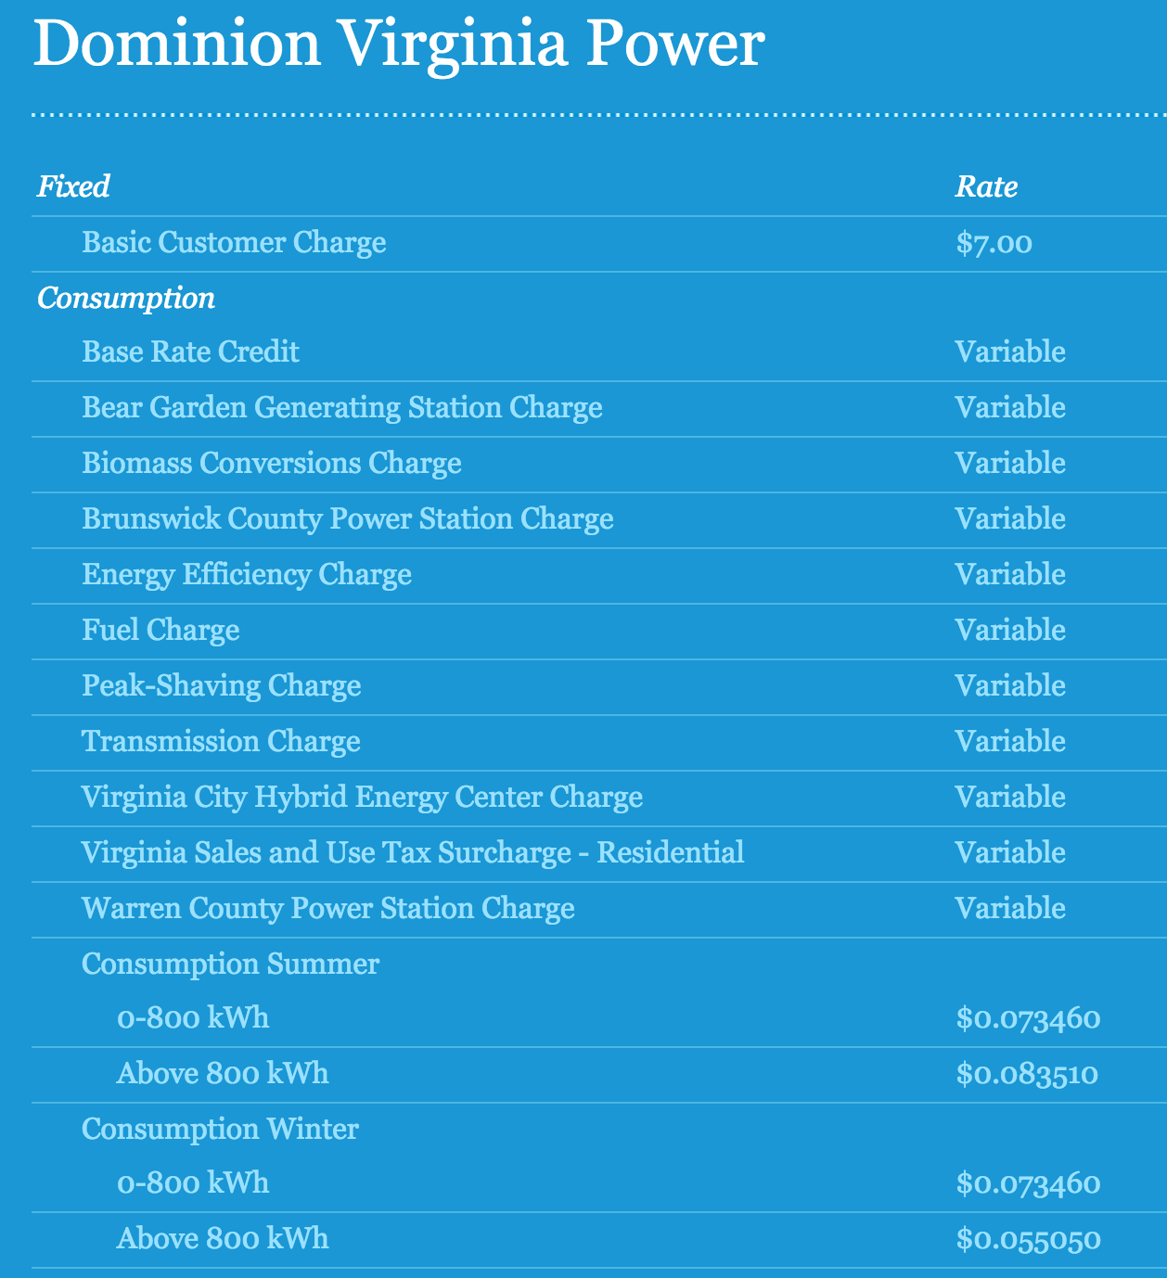
Operating Cost

Slide 9
Operating Profit
>>> kWh = 0.07
>>> hours_per_year = 24 * 365.25
>>> electricity_cost = (1.2 * kWh) * hours_per_year
>>> electricity_cost
736.344 # US $ per year
>>> profit_per_year = earnings_per_year - electricity_cost
949.4252307692309

Slide 10
Easy Money?

Slide 11
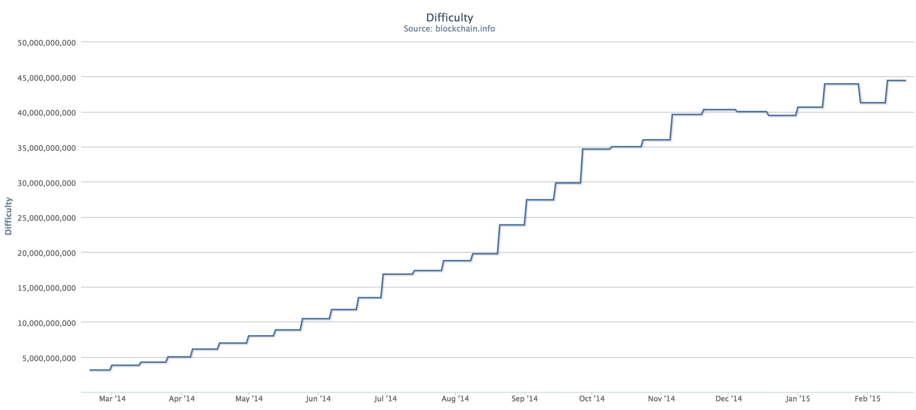
March 2014

Slide 12
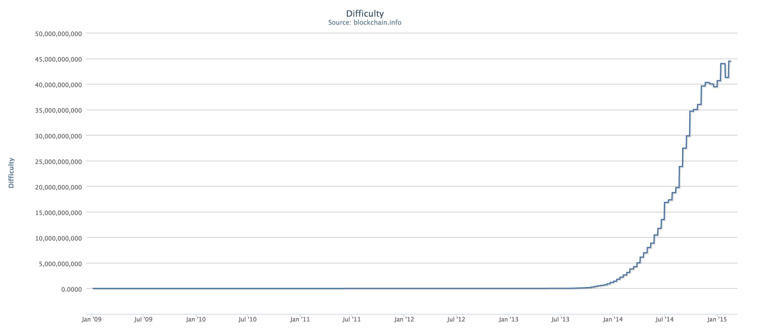

Slide 13
# this is a very low assumption - over past year, average rate was 0.35
rate_of_difficulty = 0.05
def guess_difficulty(month):
return difficulty * ((1 + rate_of_difficulty) ** month)
def expected_revenue(month):
success_probability = find_target(guess_difficulty(month)) / 2**256
return block_value * hashes_in_month * success_probability
def cummulative_income(months):
income = 0.0
month = 0
while month < months:
income += expected_income(month)
month += 1
return income

